Slide 1


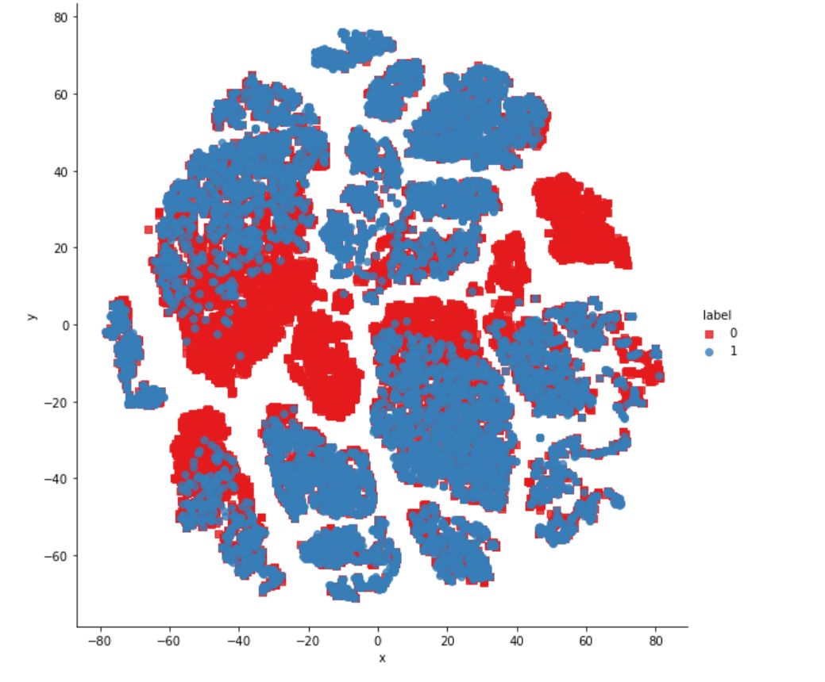
Department of Information Science and Engineering
Department of Information Science and Engineering
DUPLICATE QUESTION PAIRS DETECTION WITH
DATA ANALYSIS
Student Names and USN
Nishanth D Kini 1NT19IS100
Nanjunda Swamy Nadiga BN 1NT19IS091
N Vishwas 1NT19IS087
Dharmik MP
Guide Name:
Mr Rohith HP

Slide 2
DUPLICATE QUESTION PAIRS DETECTION
1. The main aim of this project is to detect or analyze whether the given two questions in each row of the dataset
is same or not with reference to the meaning of the sentences and thus give a conclusion whether the pair of
sentences is duplicate or not .
2. It is represented as 0→not-duplicate and 1→duplicate.
3. The ground truth is the set of labels that have been supplied by human experts. The ground truth labels are
inherently subjective, as the true meaning of sentences can never be known with certainty. Human labeling is
also a 'noisy' process, and reasonable people will disagree. As a result, the ground truth labels on this dataset
should be taken to be 'informed' but not 100% accurate, and may include incorrect labeling. We believe the labels,
on the whole, to represent a reasonable consensus, but this may often not be true on a case by case basis for
individual items in the dataset.
4. Consider the following pair of questions:
Is talent nurture or nature?
Are people talented by birth or can it be developed?
These are duplicates; they are worded differently, but they have the same intent. This project focuses on solving
the problem of duplicate question identification.

Slide 3
PHASE-2
Using pre-processing techniques and then using advanced features like Tokenization, Length-based features and Fuzzy features.
Advanced Features
Token Features
cwc_min: This is the ratio of the number of common words to the length of the smaller question
cwc_max: This is the ratio of the number of common words to the length of the larger question
csc_min: This is the ratio of the number of common stop words to the smaller stop word count among the two questions
csc_max: This is the ratio of the number of common stop words to the larger stop word count among the two questions
ctc_min: This is the ratio of the number of common tokens to the smaller token count among the two questions
ctc_max: This is the ratio of the number of common tokens to the larger token count among the two questions
last_word_eq: 1 if the last word in the two questions is same, 0 otherwise
first_word_eq: 1 if the first word in the two questions is same, 0 otherwise

Slide 4
2. Length Based Features
mean_len: Mean of the length of the two questions (number of words)
abs_len_diff: Absolute difference between the length of the two questions (number of words)
longest_substr_ratio: Ratio of the length of the longest substring among the two questions to the length of the smaller question
3. Fuzzy Features
fuzz_ratio: fuzz_ratio score from fuzzywuzzy
fuzz_partial_ratio: fuzz_partial_ratio from fuzzywuzzy
token_sort_ratio: token_sort_ratio from fuzzywuzzy
token_set_ratio: token_set_ratio from fuzzywuzzy
Using all these extra features and by applying pre-processing techniques we are improving the accuracy of the particular problem.

Slide 5
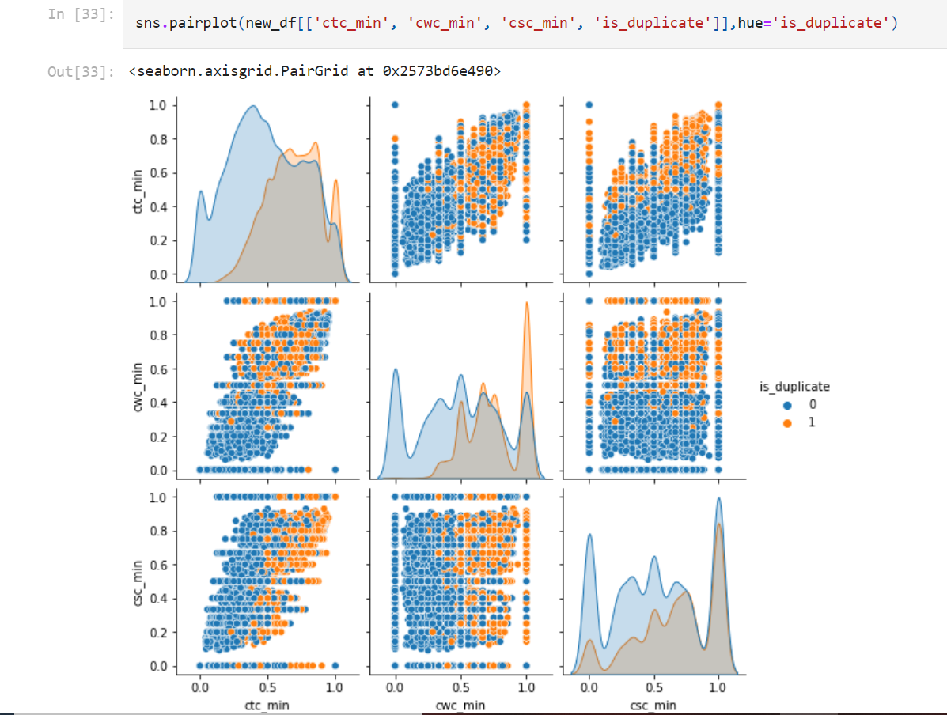

Slide 6
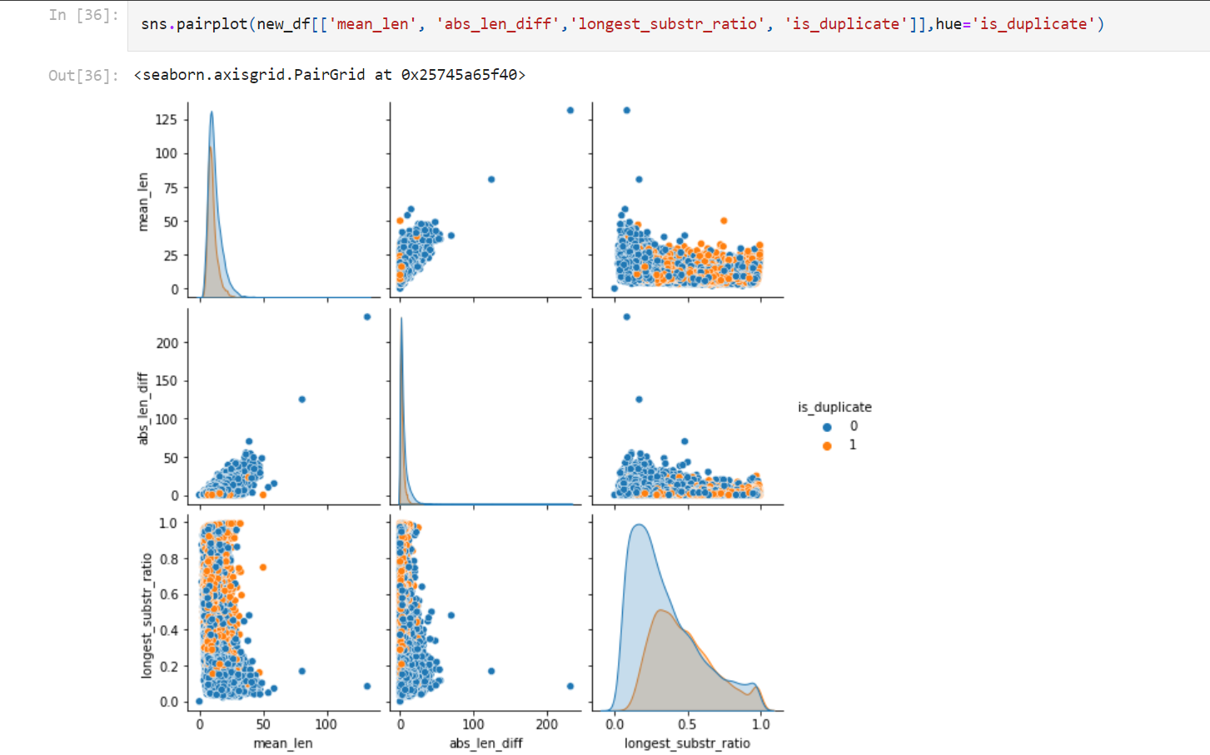

Slide 7
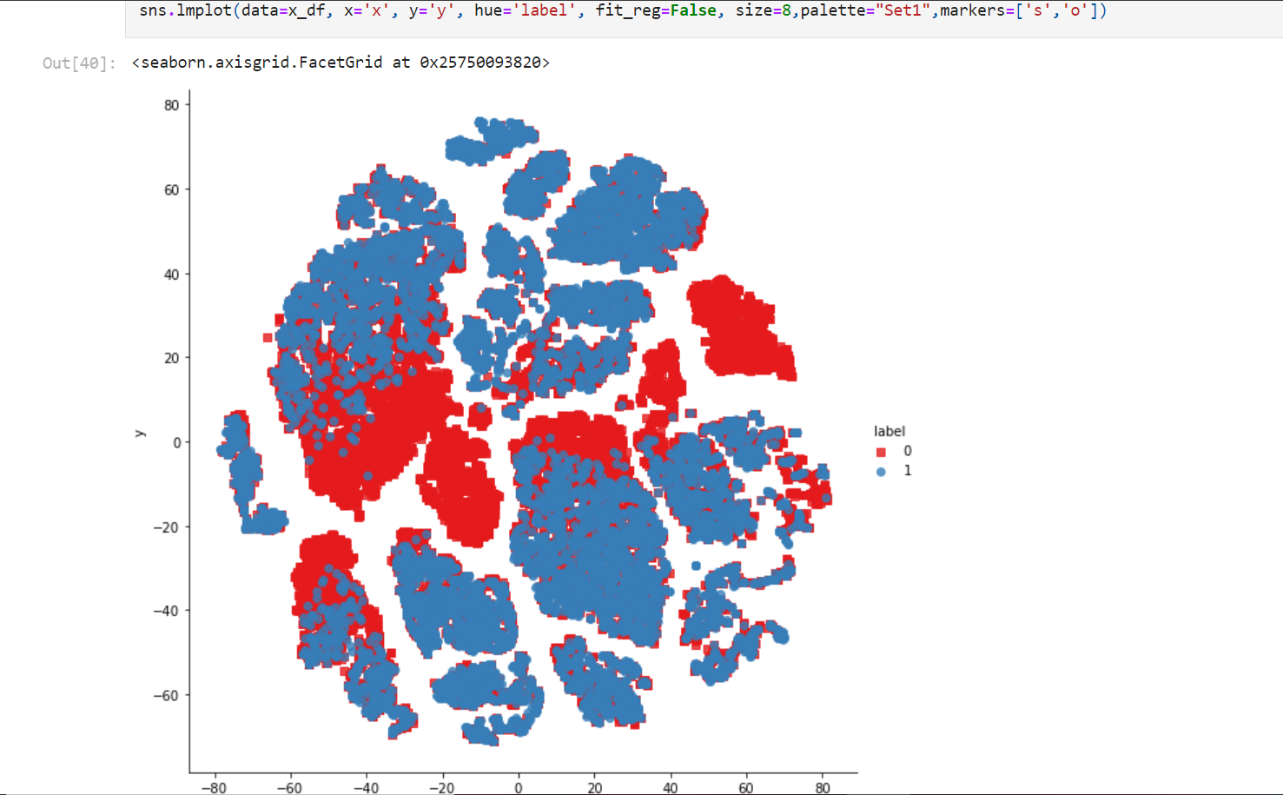

Slide 8
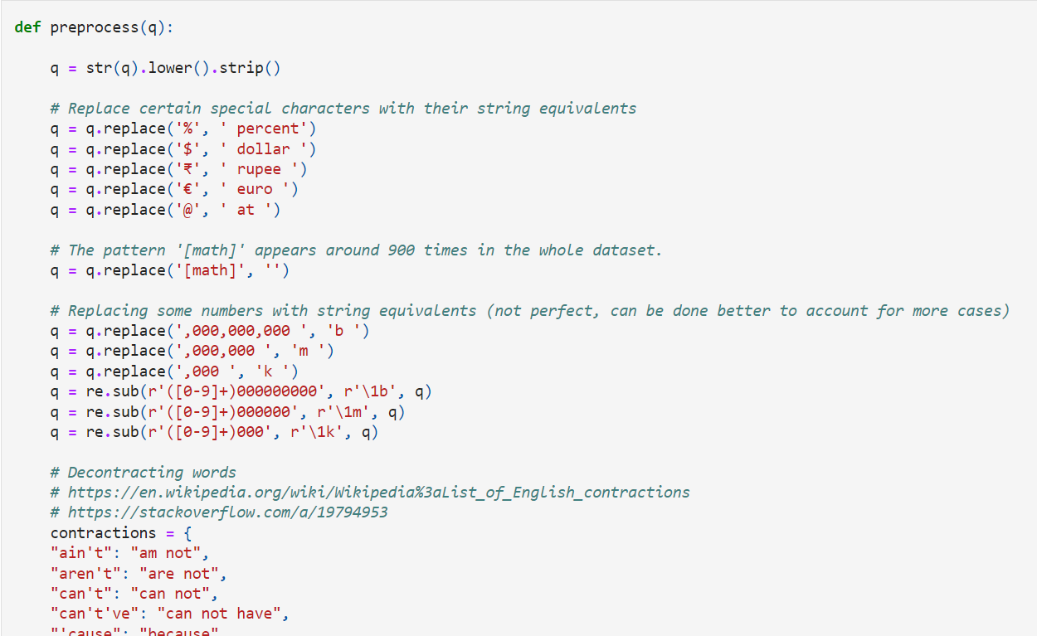
PRE-PROCESSING TECHNIQUES APPLIED

Slide 9
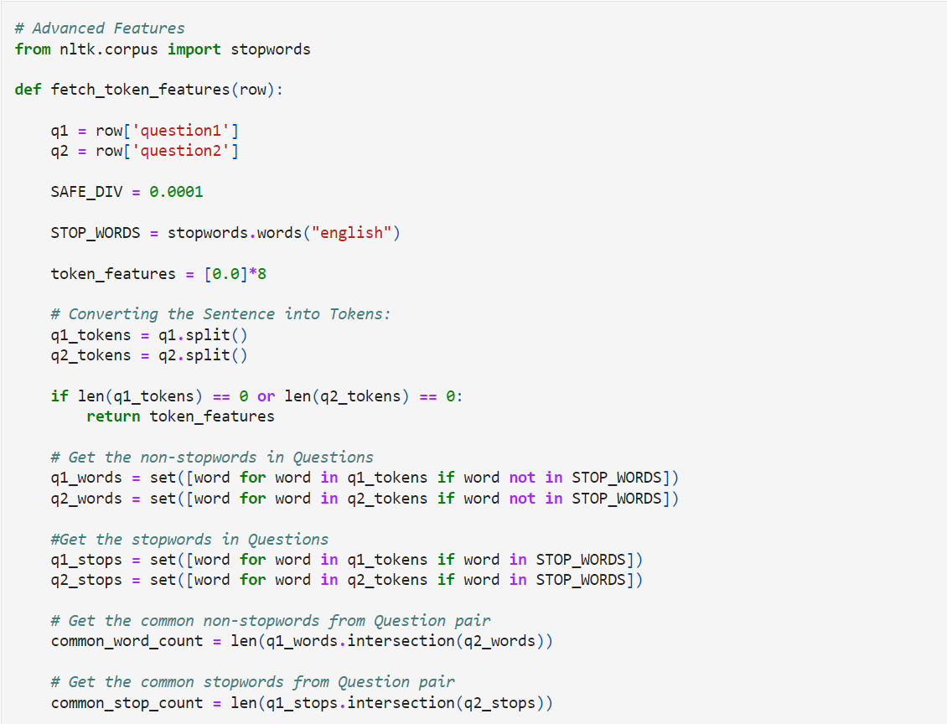
ADVANCED FEATURES ADDED…

Slide 10
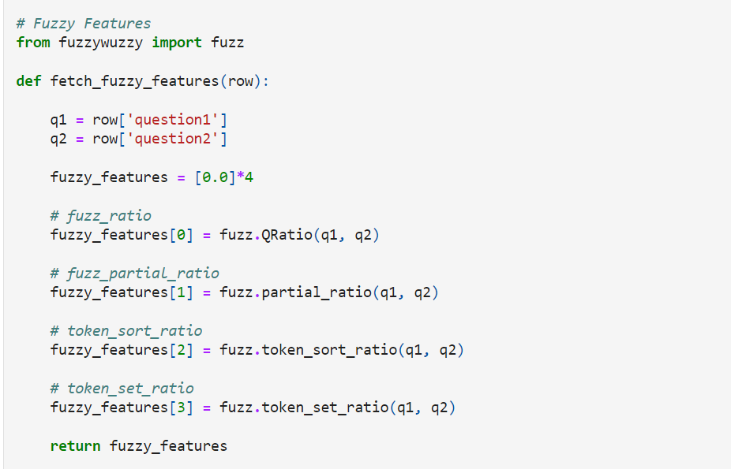
FUZZY FEATURES

Slide 11
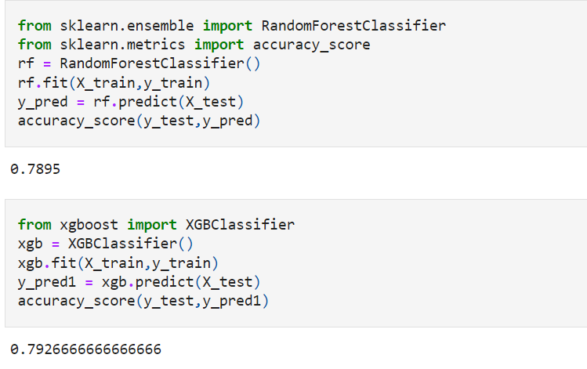
ACCURACY IMPROVISATION…

Slide 12
